Slide 1
Topic Modelling Using LDA

Slide 2
What is Topic Modelling?
Topic modeling is a method for unsupervised classification of documents, similar to clustering on numeric data, which finds some natural groups of items (topics) even when we’re not sure what we’re looking for.
Topic modeling provides methods for automatically organizing, understanding, searching, and summarizing large electronic archives.
It can help with the following:
discovering the hidden themes in the collection.
classifying the documents into the discovered themes.
using the classification to organize and summarize.

Slide 3
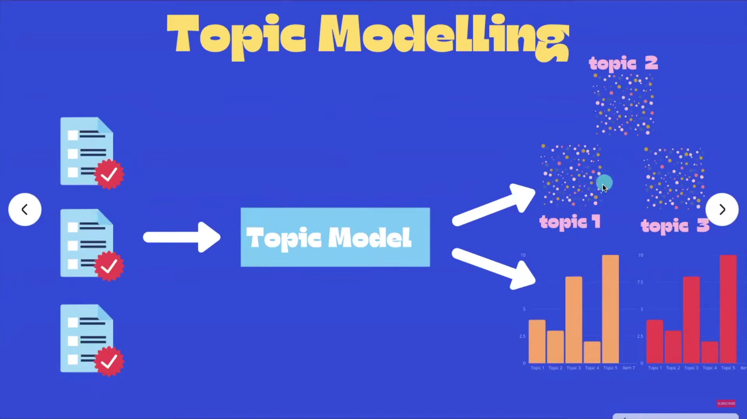
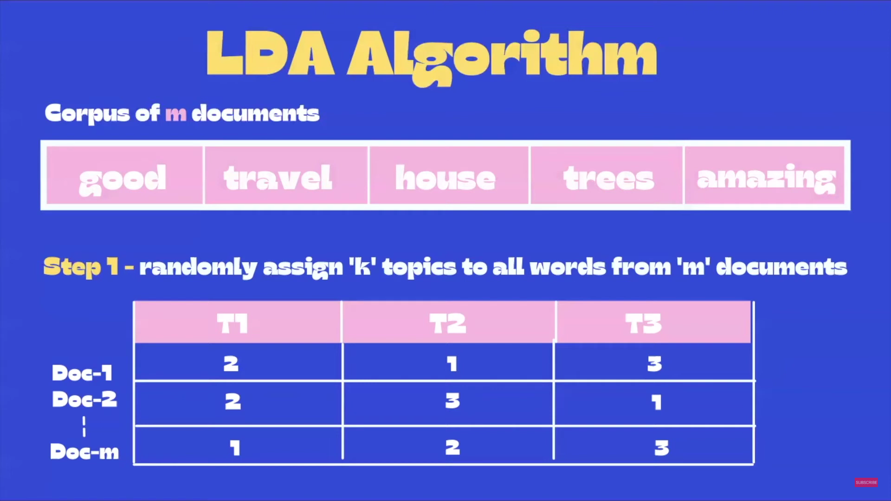
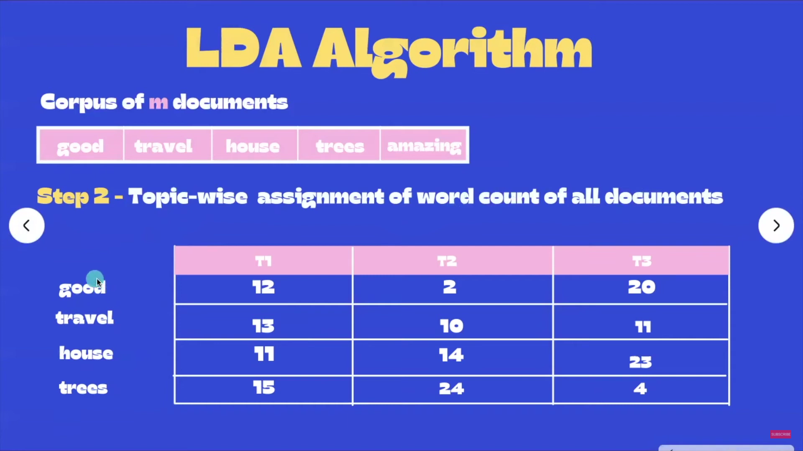
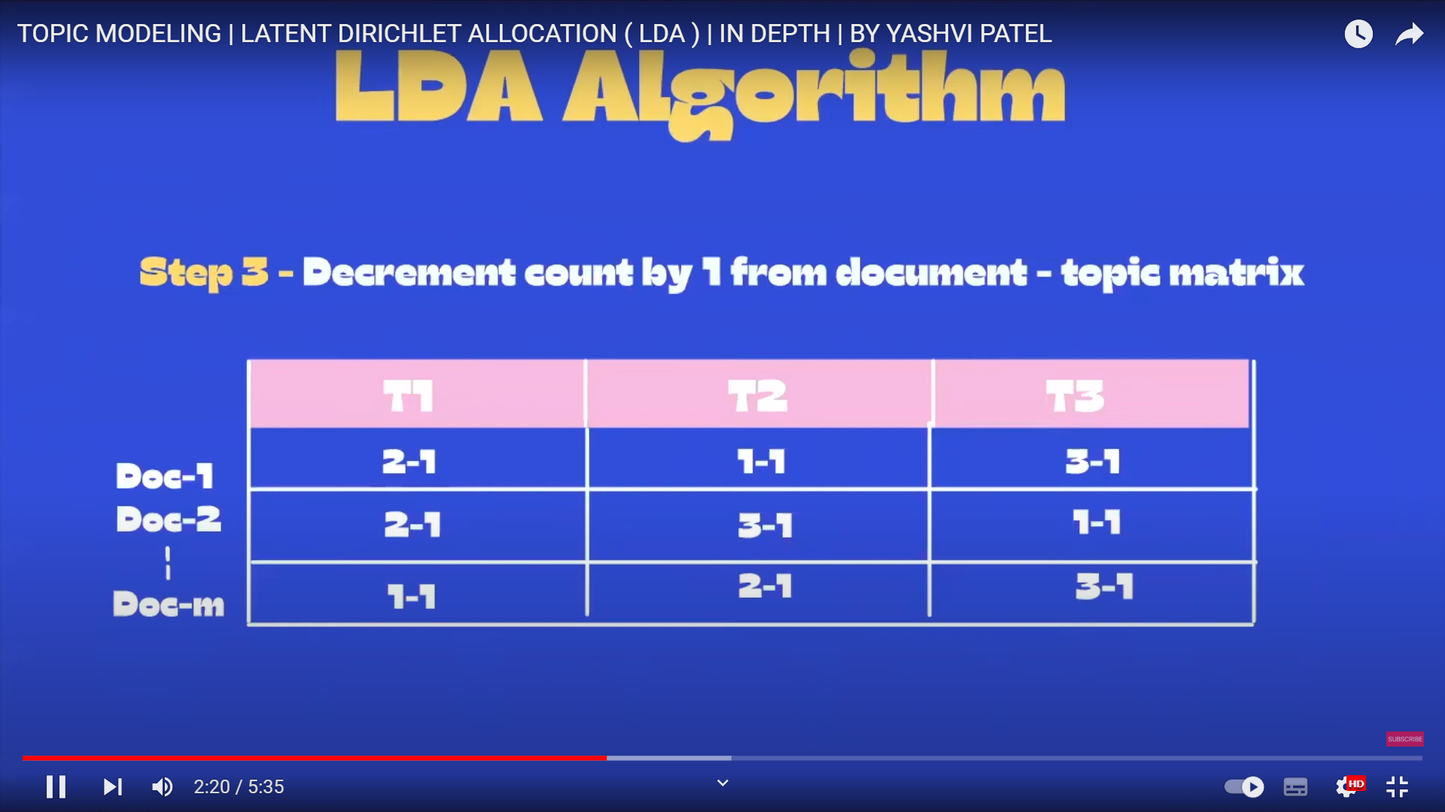

Slide 4
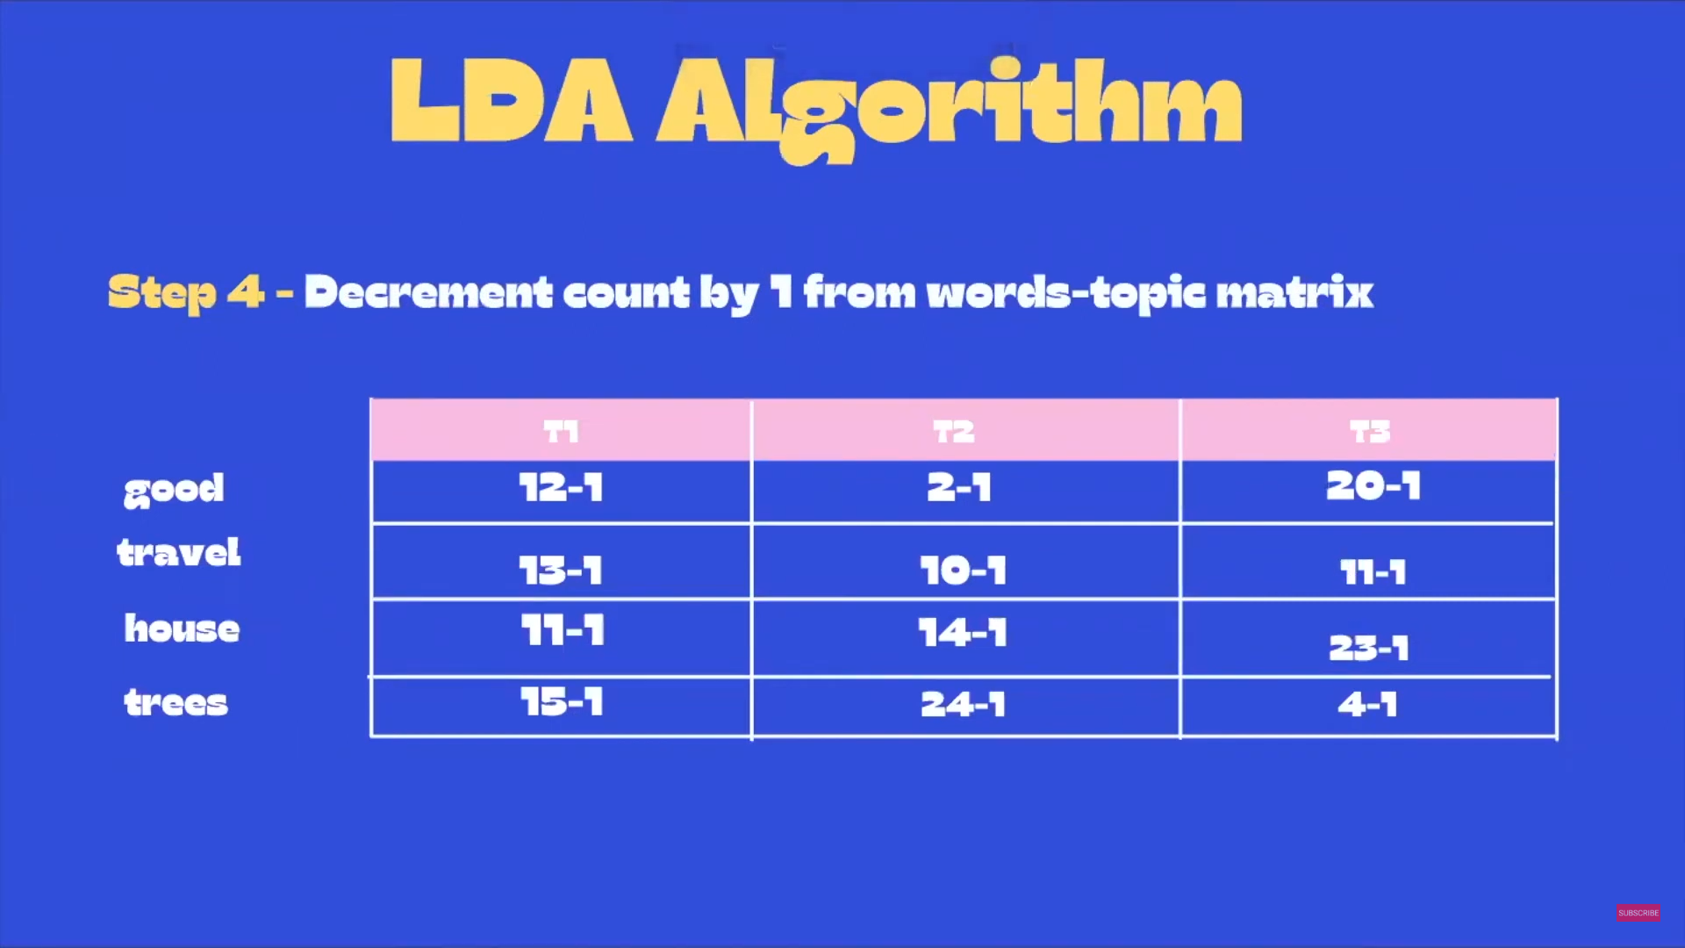
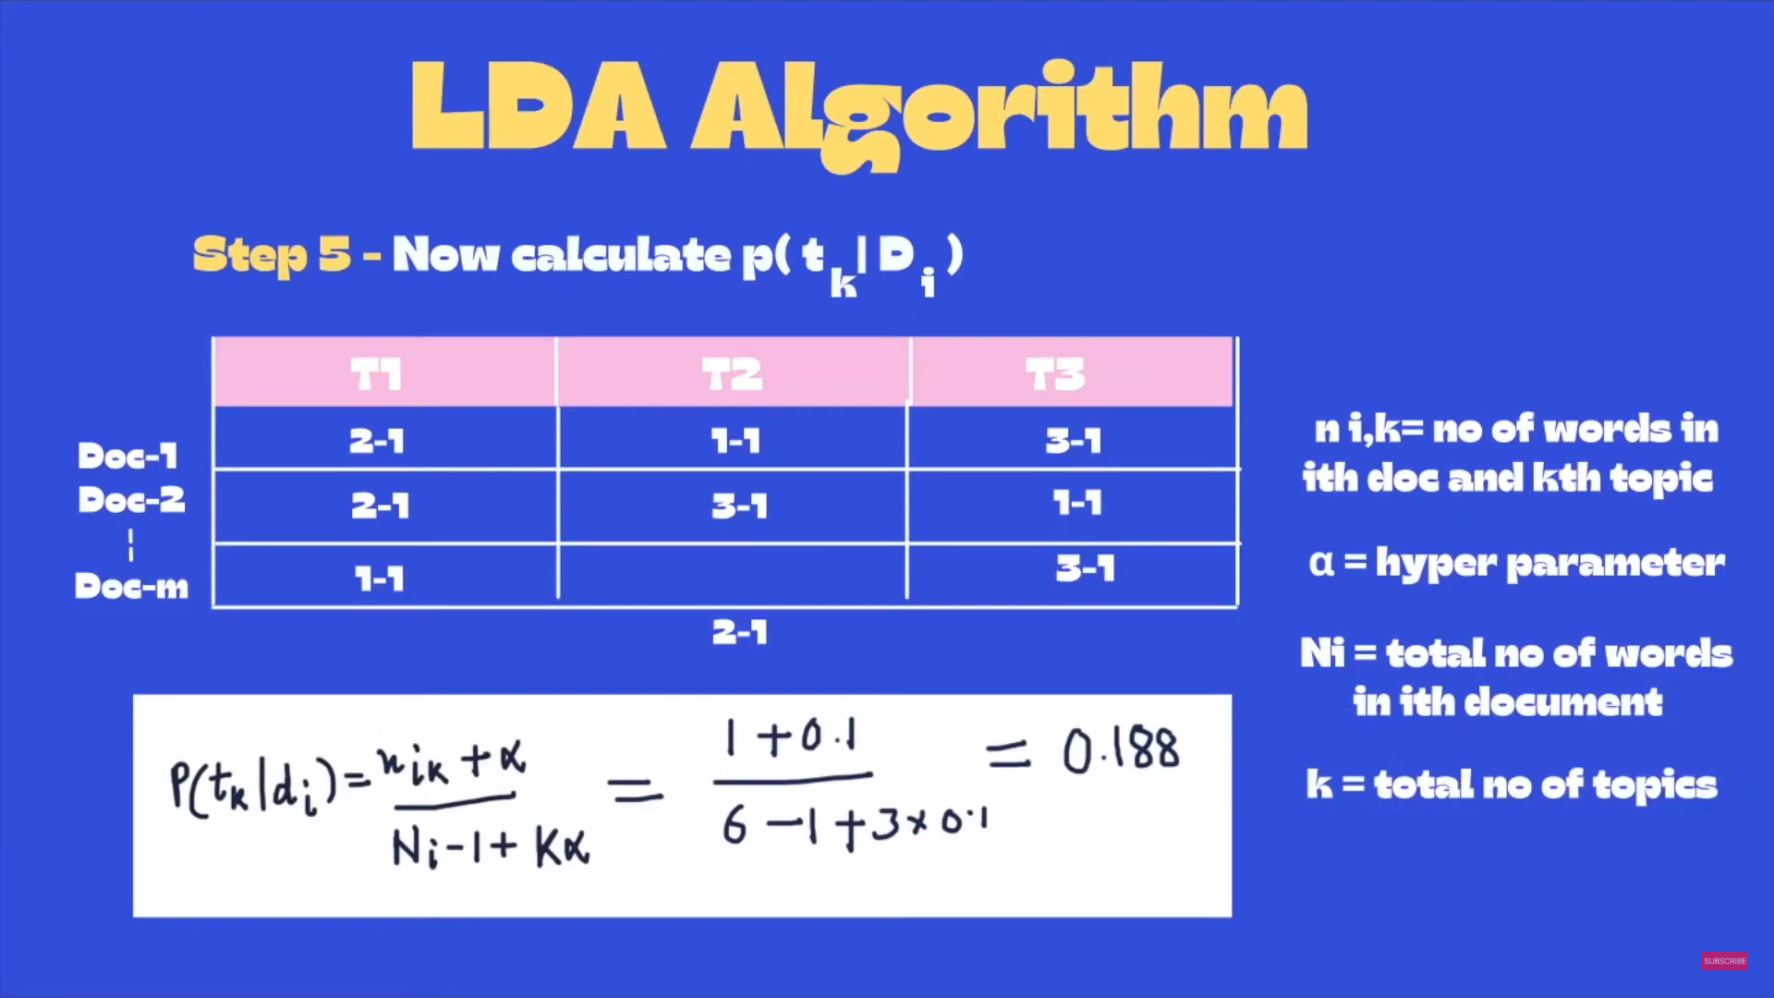
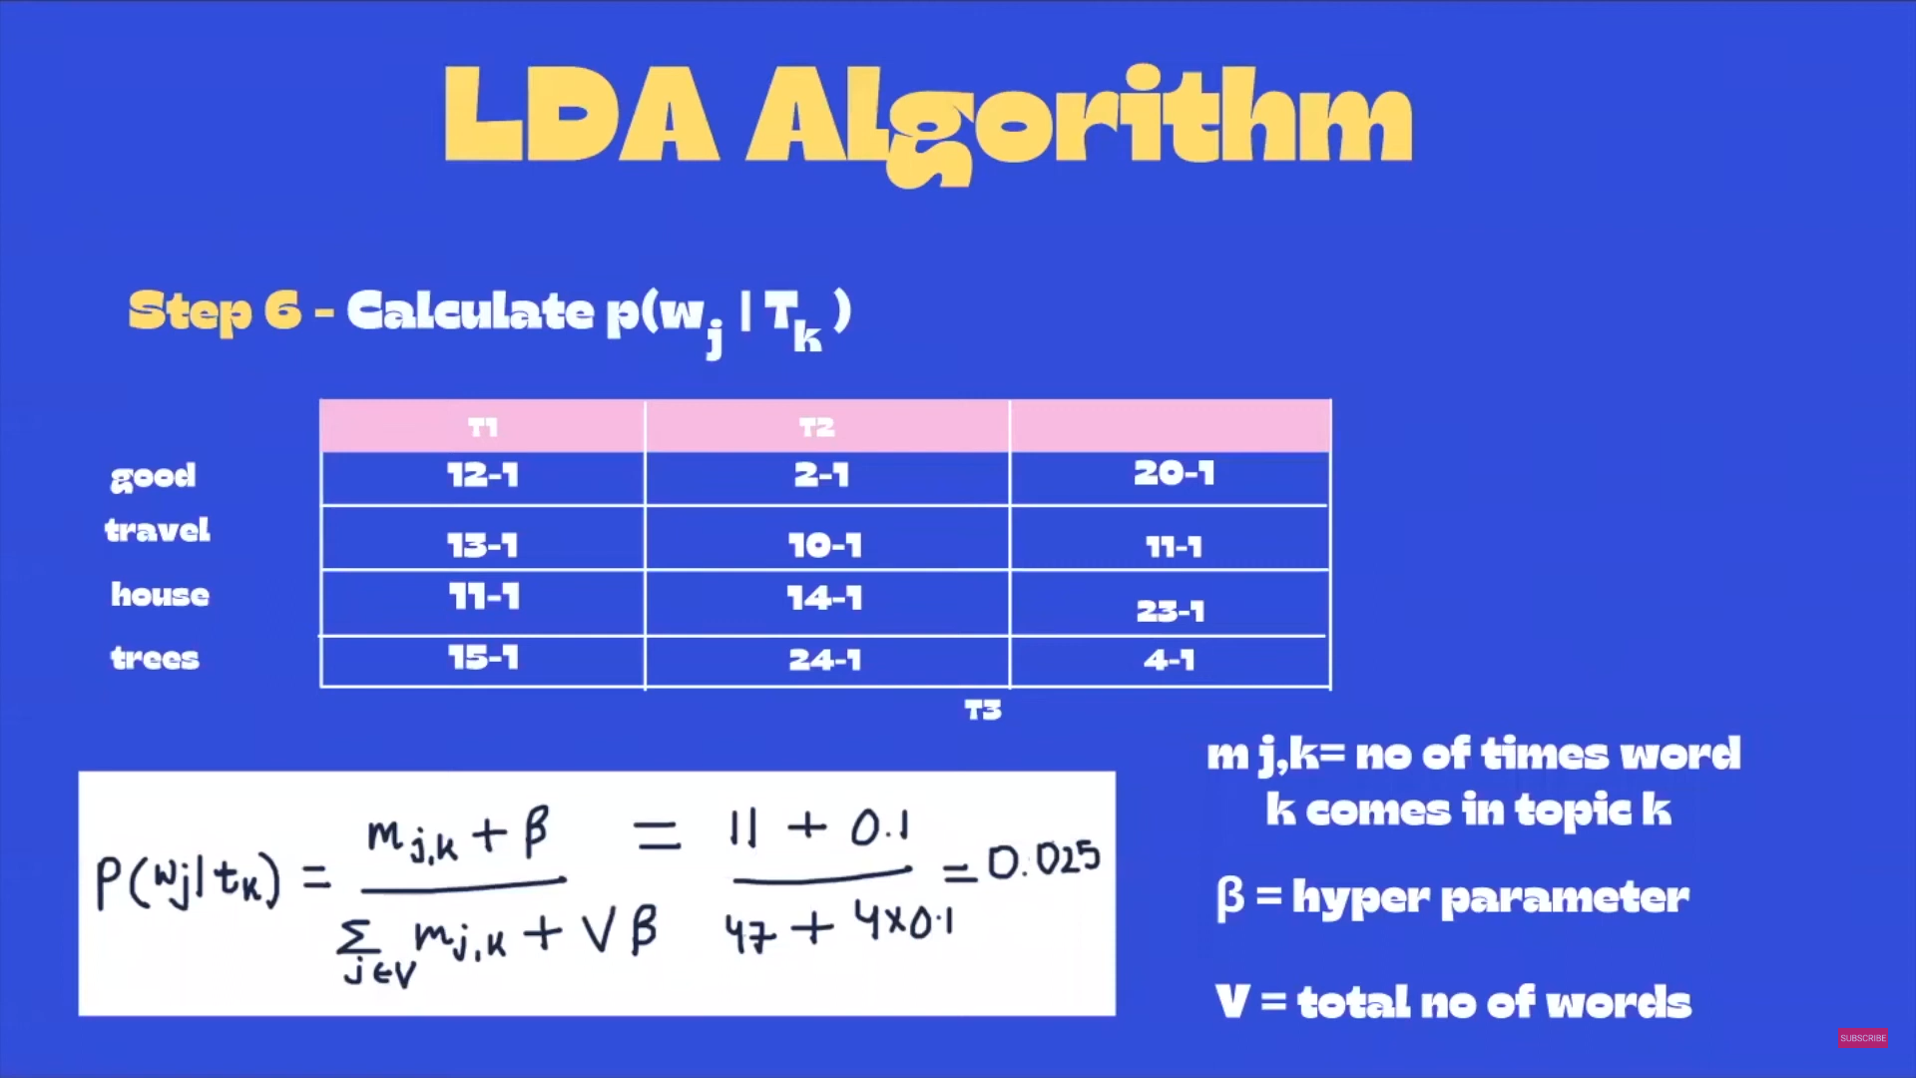
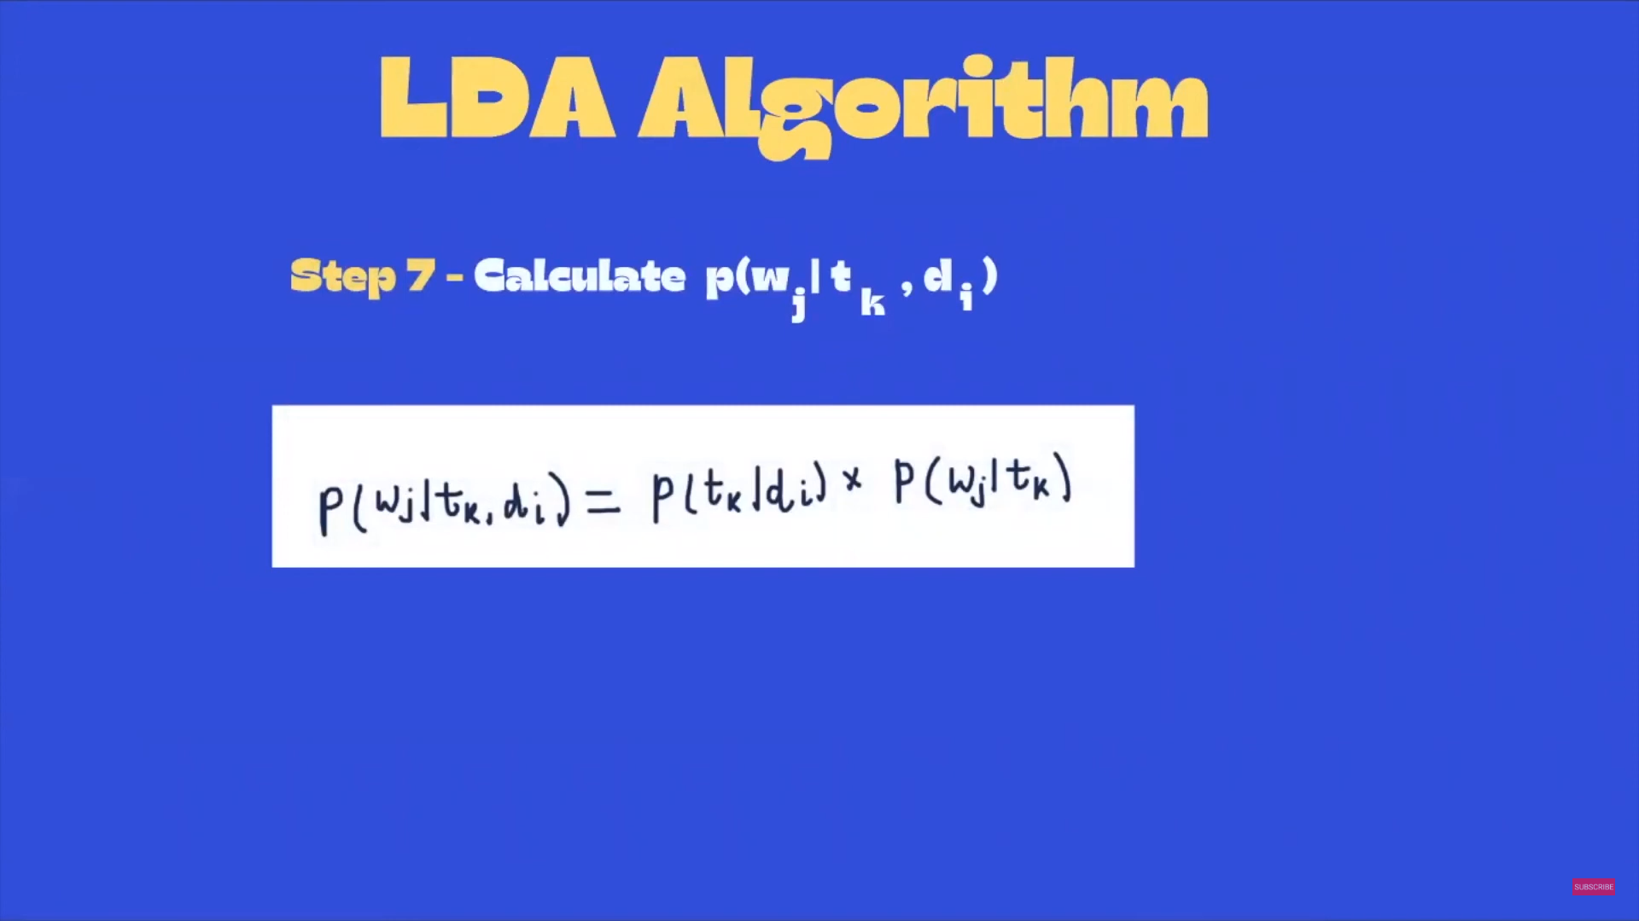
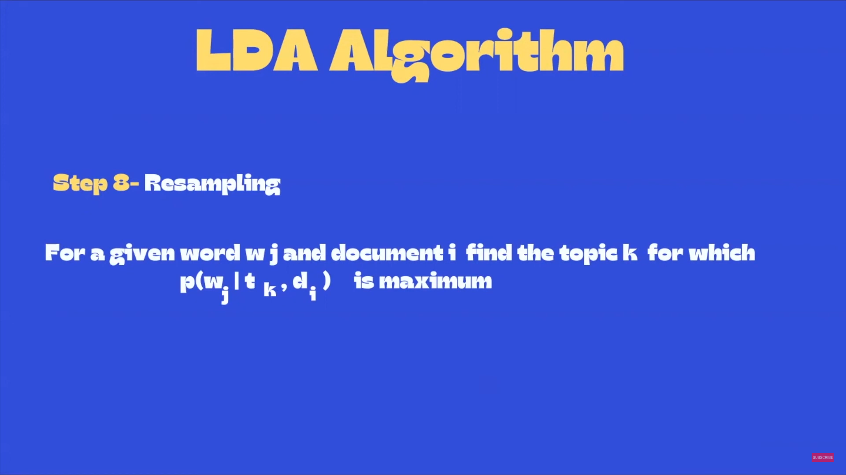

Slide 5
The Data
Recent 4 newspaper editorial based on Russia – Ukraine war has been taken from the newspaper The Guardian.
The Guardian is a British daily newspaper. It was founded in 1821 as The Manchester Guardian, and changed its name in 1959. Along with its sister papers, The Observer and The Guardian Weekly, The Guardian is part of the Guardian Media Group, owned by the Scott Trust. The trust was created in 1936 to "secure the financial and editorial independence of The Guardian in perpetuity and to safeguard the journalistic freedom and liberal values of The Guardian free from commercial or political interference". The trust was converted into a limited company in 2008, with a constitution written so as to maintain for The Guardian the same protections as were built into the structure of the Scott Trust by its creators. Profits are reinvested in its journalism rather than distributed to owners or shareholders. It is considered a newspaper of record in the UK.

Slide 6
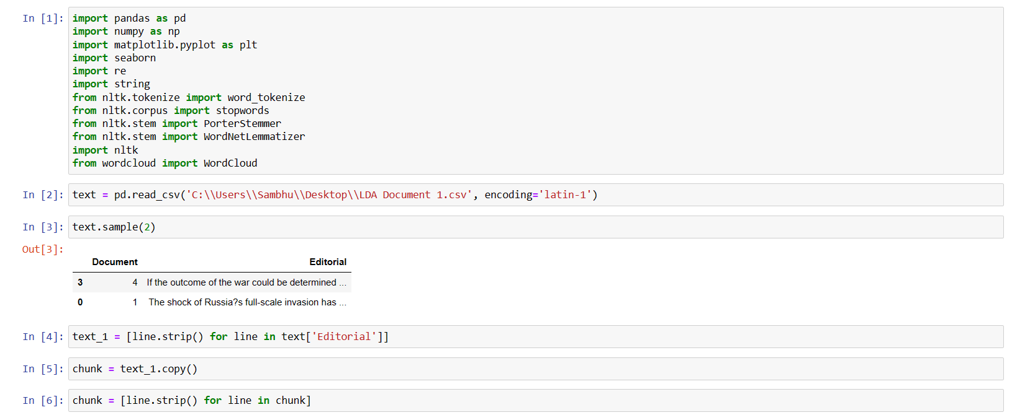

Approach

Slide 7
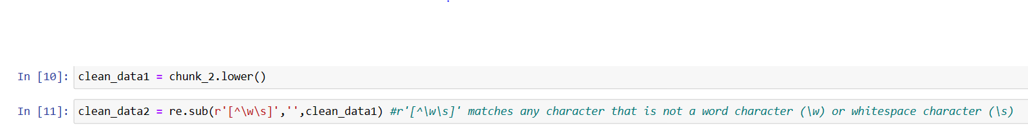
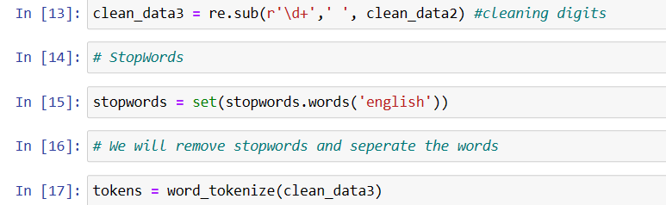
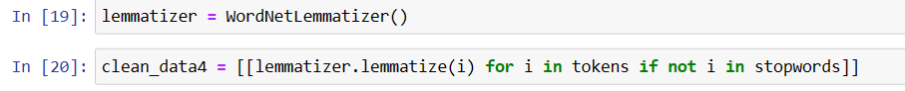

Slide 8
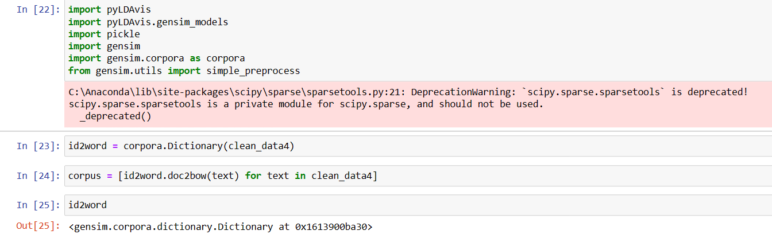
The code id2word = corpora.Dictionary(clean_data4) creates a dictionary that maps each unique word in the clean_data4 list to a unique integer ID.
The corpus = [id2word.doc2bow(text) for text in clean_data4] code creates a corpus of documents, where each document is represented as a bag-of-words. Specifically, it creates a list of document-term frequency (DTF) vectors, where each DTF vector is a list of (word_id, count) tuples representing the frequency of each word in the document.

Slide 9
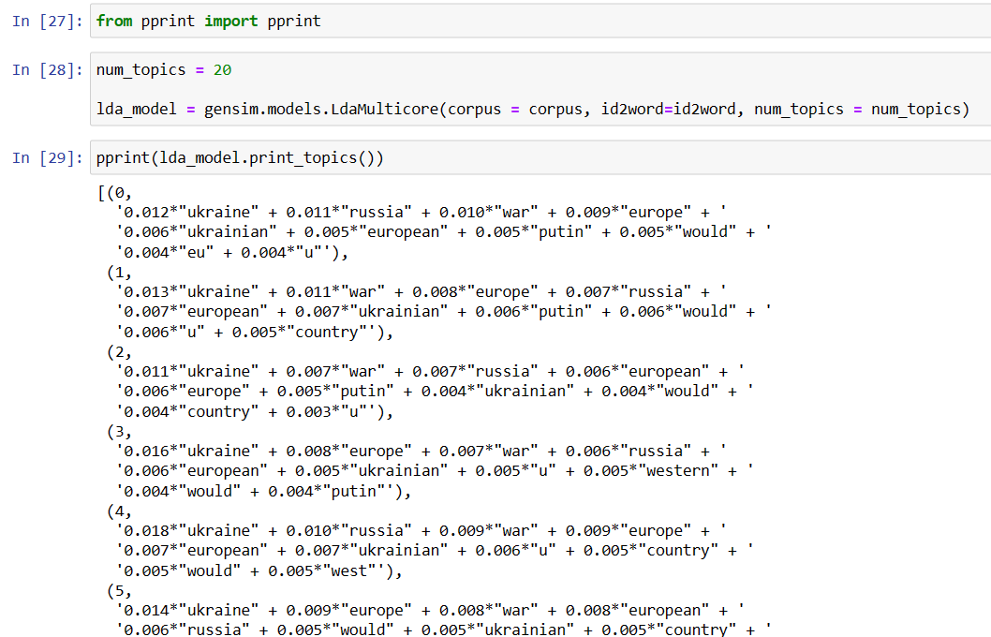

Slide 10
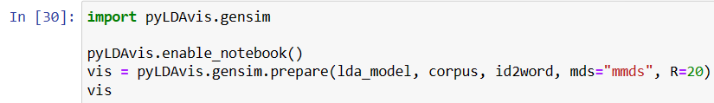
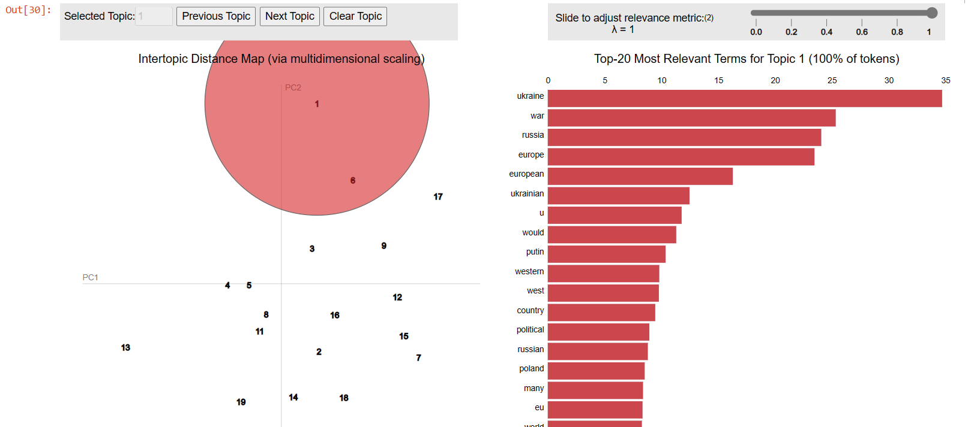
The Findings

Slide 11
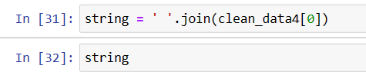
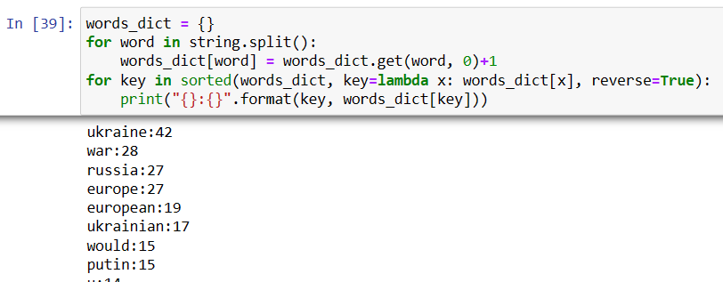

Slide 12
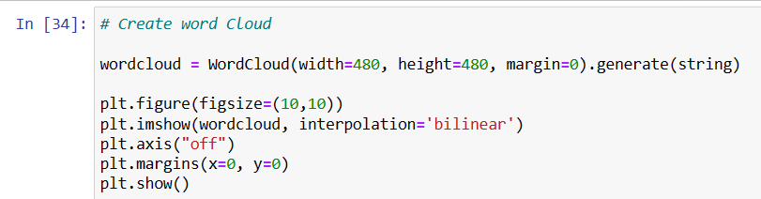
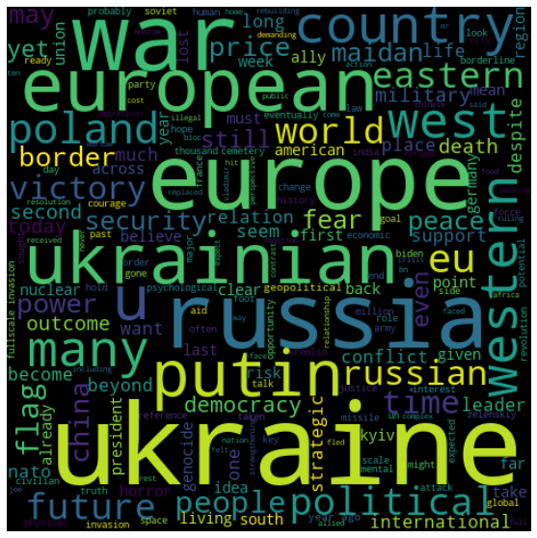

Slide 13
References
https://youtu.be/3oHXpWIvIBs - Analytics Vidya Data Hour
https://youtu.be/VsjYyxd_LaU - Yashvi Patel
https://radimrehurek.com/gensim/models/ldamulticore.html - Gensim Documentation
https://www.theguardian.com/commentisfree/2023/feb/23/the-guardian-view-on-war-in-ukraine-reshaping-the-world
https://www.theguardian.com/commentisfree/2023/feb/19/the-observer-view-on-the-war-in-ukraine-one-year-on-an-even-more-dangerous-phase-may-await
https://www.theguardian.com/commentisfree/2023/mar/02/europe-ukrainians-dead-heroes-putin
https://www.theguardian.com/commentisfree/2022/nov/13/poland-russia-defeat-ukraine-western-europe

